Slide 1
Topic: Algebra EQ: How do we solve Equations When There’s Brackets?
Year 8 Mathematics
Mrs Parlevliet

Slide 2
Contents
Glossary or Formula Page
Page
Date
Essential Question
24
7
30
Word or Formula
Definition or Example

Slide 3
Tasks
24
7
30
Topic
Essential Question
Questions
Notes
Summary
1
2

Slide 4
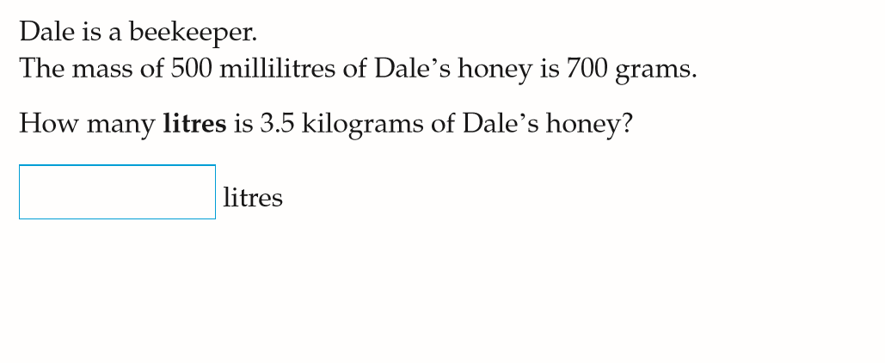

Five Questions (LHS)
Date: XX/XX/2019
Topic: Algebra
EQ – How do we solve equations with brackets?
Solve the unknown in $3x+4=13$
Give an example of collecting continuous numerical data
If $c=4$, what is the value of $4c−2$
Simplify the expression, $3x+5y−7x+8y$

Slide 5
24
7
30
WICOR
Topic: Algebra
Date: XX/XX/2019
EQ: How do we solve equations when there are brackets?
What are the steps that I need to take to solve an equation with brackets?
Steps
Expand the brackets and collect any like terms
Use either backtracking or balancing method to solve for the variable

Slide 6













24
7
30
WICOR
Topic: Algebra
Date: XX/XX/2019
EQ: How do we solve equations when there are brackets?
OPTION 1: Backtracking
$$2(x+4)=26$$
$$2x+8=26$$
$$×2$$
$$+ 8$$
$$x$$
$$2x$$
$$2x+8$$
$$9$$
$$18$$
$$26$$
+
$$−$$
$$÷2$$
$$− 8$$
×
÷
Notes:
If students don’t know where to begin, give them a clue that they need to use Order of Operations to link the numbers on the vertices to the number inside the triangle.

Slide 7









24
7
30
WICOR
Topic: Algebra
Date: XX/XX/2019
EQ: How do we solve equations when there are brackets?
OPTION 2: Balancing both sides
$$3(x −2) =9$$
$$3x −6 =9$$
$$+ 6$$
$$+ 6$$
$$3x =15$$
$$÷3$$
$$÷3$$
+
$$−$$
$$x =5$$
×
÷
Notes:
If students don’t know where to begin, give them a clue that they need to use Order of Operations to link the numbers on the vertices to the number inside the triangle.

Slide 8
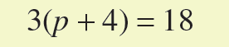










Example 1
Backtracking Method
$$×3$$
$$+ 12$$
$$p$$
$$3p$$
$$3p+12$$
$$2$$
$$6$$
$$18$$
$$÷3$$
$$− 12$$

Slide 9
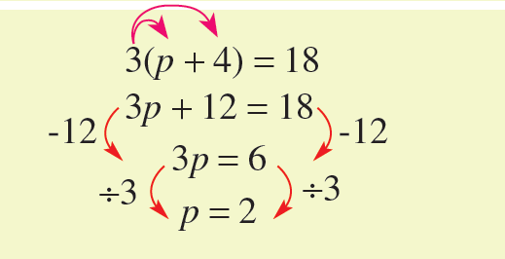
Example
Balancing Method

Slide 10



WE DO (LHS)
$$2(2x+5)=30$$
$$4x+10=30$$
+
$$−$$
×
÷

Slide 11
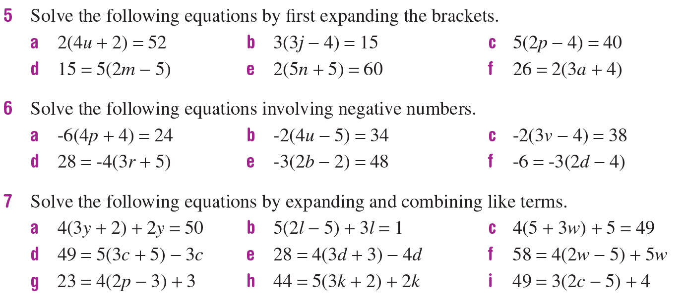
Task: Complete the Questions (LHS)

